Slide 1

Welcome
RentalGuardian New Damage Claims Enhancement
Training Guide
RentalGuardian.com

Slide 2
RENTALGUARDIAN TRAINING
1
RentalGuardian Damage Claims Portal
Agenda
Claim intake portal— submit loss details for your claim
What we'll cover today
2
Claim Tracking & Communication
Claim portal — track your claim, and communicate with claims team

Slide 3

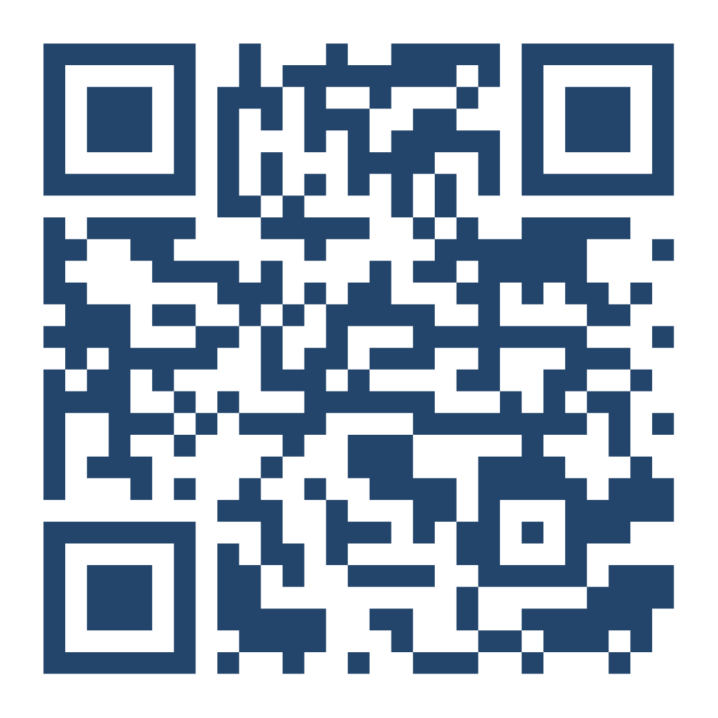
SECTION 01
RG Damage Claims Portal
Our guided claim intake portal collects accurate, complete claim information from the start.
Smart.ly is a claims submission tool powered by our claims team.
All of this — right from your mobile device or computer!

Slide 4


What’s Improved
Clear, Guided Process
Step-by-step form that makes submitting claims simple and intuitive in 10 minutes!
Faster Claim Reviews
  Complete submissions reduce delays and we're using intelligent automation to improve claim accuracy, completeness, and speed.
More Accurate Information
  Structured inputs ensure all required details are captured correctly.
Submission Timeline
The new process does not have a specific timeline but claims should be reported as reasonably practical after a loss is discovered.​
RentalGuardian Training | RentalGuardian New Damage Claims Enhancement
4

Slide 5
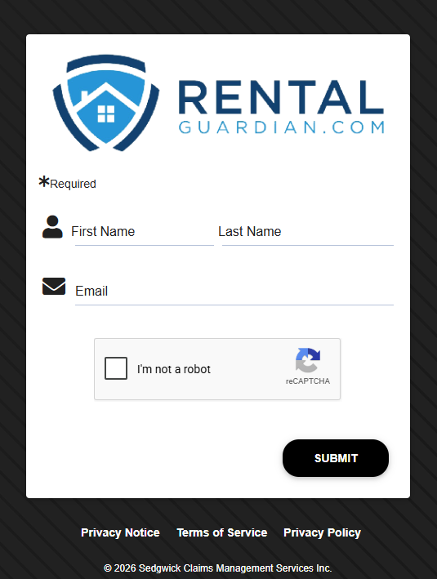
Welcome & Login
Introduction
This guide helps you report claims quickly and efficiently.
URL: https://intake.sedgwick.com/u/2530/intake
Please note:
Scope: Damage claims (Guest-caused accidental damage).
You are required to include at least 2 photos (damaged item and related invoice/receipt) to proceed with your claim.
File upload limit: Each file must be 6 MB or smaller. Compress or resize files that exceed this limit before uploading.
Required fields: Complete all fields marked with an asterisk — they are required to submit your claim.
RentalGuardian Training | RentalGuardian New Damage Claims Enhancement
4

Slide 6
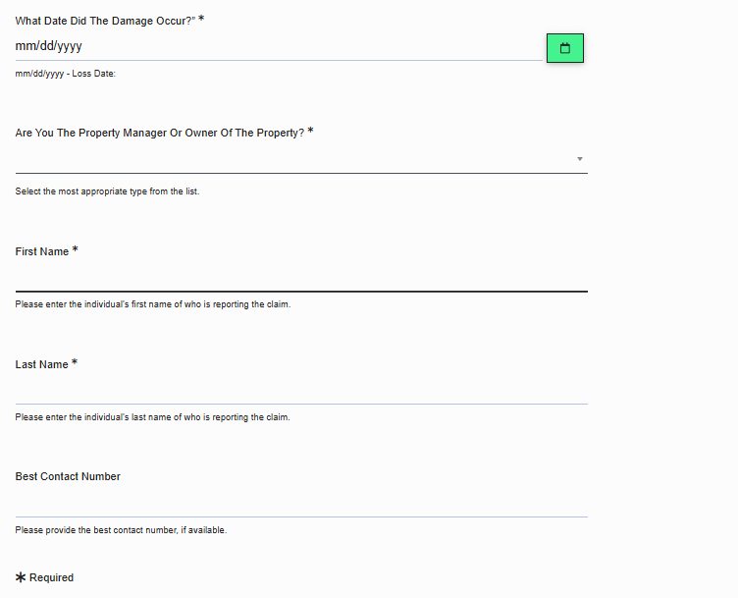
Reporter Information
Fill in the damage date & your identity i.e. your first & last name.
Select how you were first notified of the damage or loss.
Confirm whether you are the property owner, manager, or guest.
Please note:
The portal does not save progress. If idle for more than 20 minutes, you must restart.
Claim should be reported as reasonably practical after a loss is discovered.
RentalGuardian Training | RentalGuardian New Damage Claims Enhancement
5

Slide 7
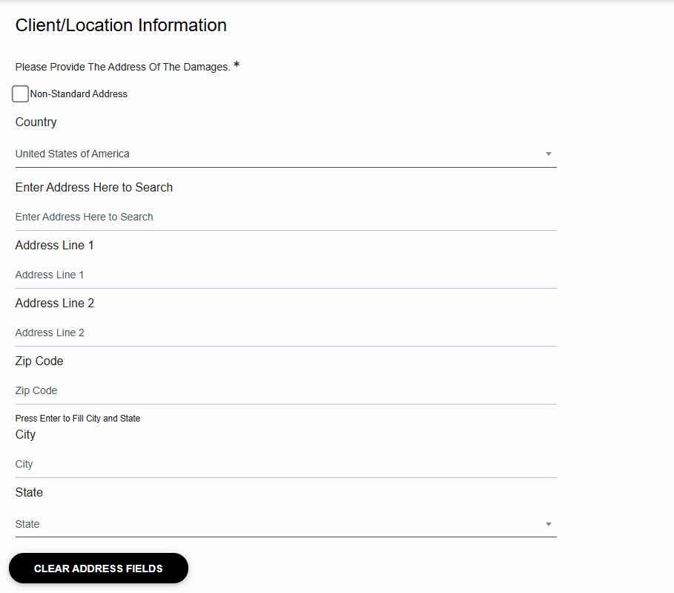
Location Information
Enter the full address of the affected property.
Includes country, address, city, state, and ZIP/postal code.
Include unit/suite details.
This ties the loss to the correct property record.
Non-Standard Address Option:
Use when the address does not autofill or match
Allows you to manually enter property details
Enables you to proceed with the claim
RentalGuardian Training | RentalGuardian New Damage Claims Enhancement
6

Slide 8
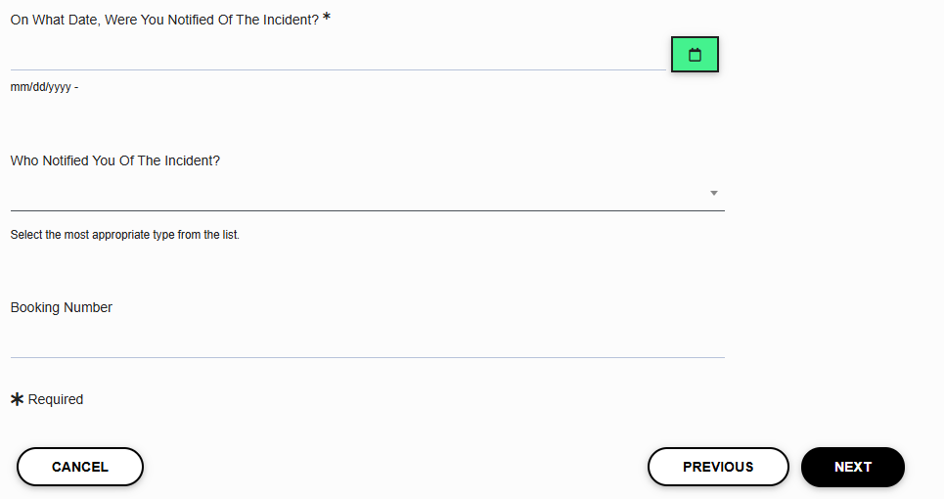
Damage Information
Enter when the damage was first reported.
Select who notified you of the damage or loss.
Enter the booking number related to the damage.
RentalGuardian Training | RentalGuardian New Damage Claims Enhancement
5

Slide 9
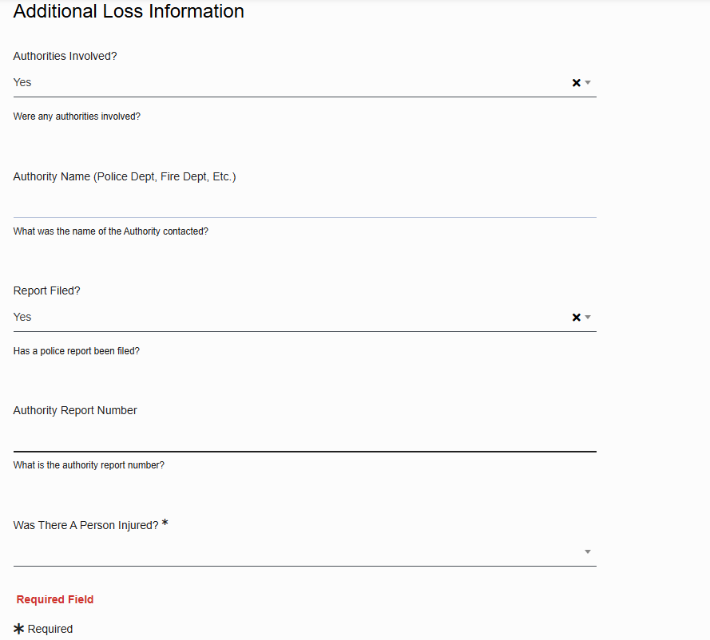
Loss Information
Indicate whether police, fire, or other authorities were notified.
If "Yes" for Authorities Involved
Include the authority's name
If "Yes" for Report Filed include the report number
If "No" or "Unknown" for Authorities Involved
Proceed to answer if a person was injured
If "Yes" for Report Filed include the report number
RentalGuardian Training | RentalGuardian New Damage Claims Enhancement
7

Slide 10
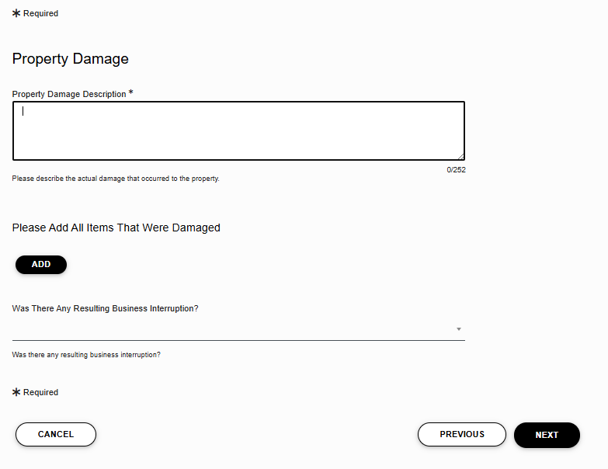
Property Damage
Describe the damage(s).
When clicking Add, attach photos for each damaged item. Add items one at a time.
Select whether the damage resulted in business interruption.
If "Yes" for Business Interruption
Provide the date & time when the business functions stopped.
Provide the date & time when the business became available.
Please note:
Please only upload images of the selected damage. You will be able to add additional documentation (receipts or invoices) later in the portal.
RentalGuardian Training | RentalGuardian New Damage Claims Enhancement
8

Slide 11
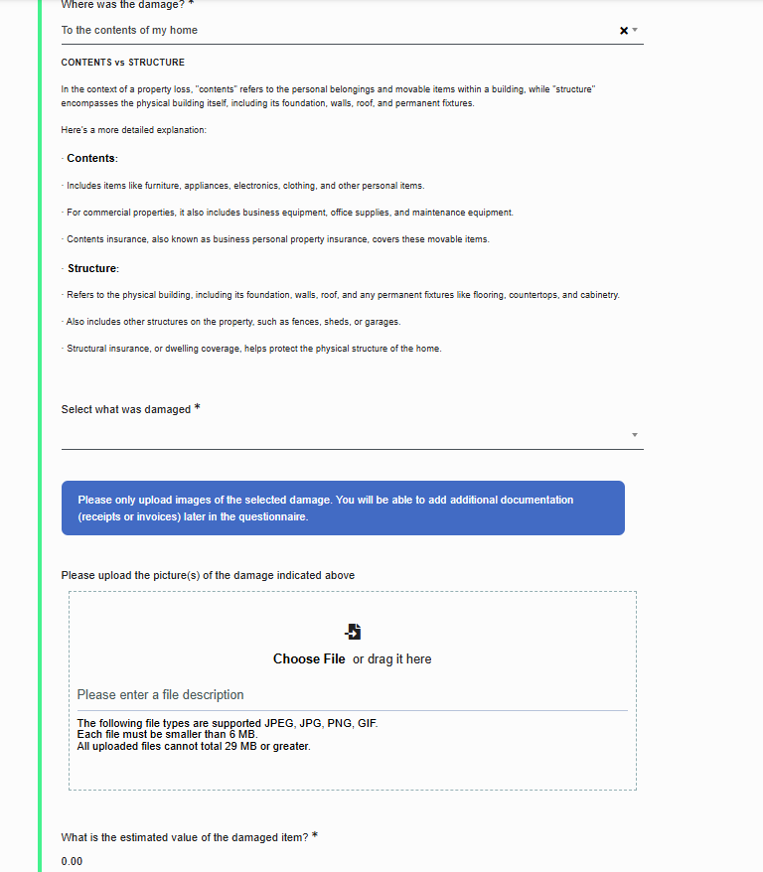
Property Damage (continued)
Click "Add" to upload photos of the damages
Select whether the damage affected the structure or contents.
Upload photos — intelligent automation helps improve claim accuracy and speed.
Provide an estimated value of the item, or enter $1 if uncertain.
Please note:
Please only upload images of the selected damage. You will be able to add additional documentation (receipts or invoices) later in the portal.
RentalGuardian Training | RentalGuardian New Damage Claims Enhancement
9

Slide 12
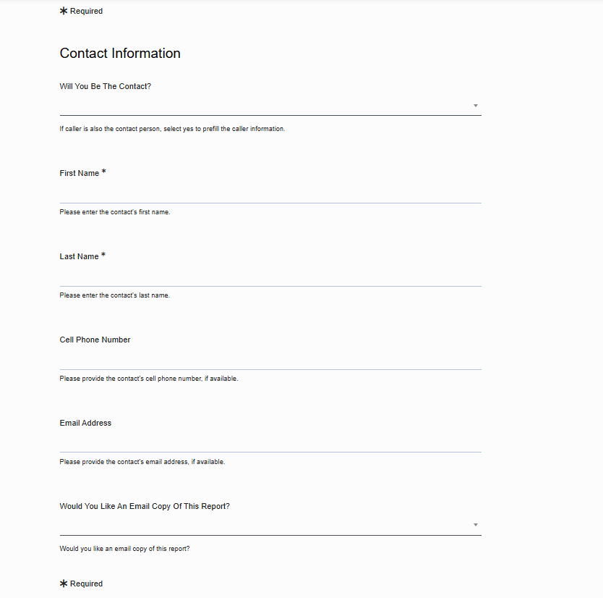
Contact Information
Select the point of contact (PoC) for this claim.
If "No" is selected, please provide PoC details.
Provide an email address if you want an email copy of the report.
RentalGuardian Training | RentalGuardian New Damage Claims Enhancement
10

Slide 13
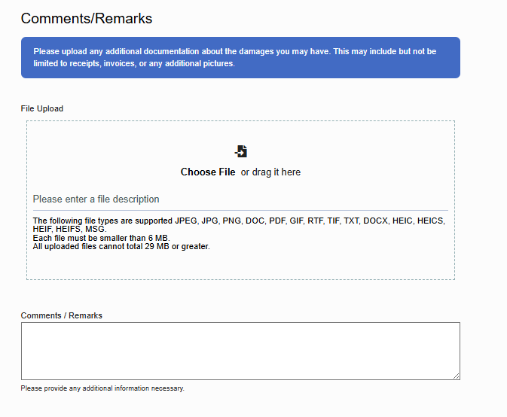
Comments / Remarks
Please attach your paid receipt and/or invoice for the claimed loss. For multiple items, upload all receipts/invoices at once.
Attach any labor invoices with proof of payment for review.
Use the free-text field for additional context or special circumstances.
Click next to review your claim before submitting.
Please note:
This information is required for claims investigation to begin.
RentalGuardian Training | RentalGuardian New Damage Claims Enhancement
11

Slide 14
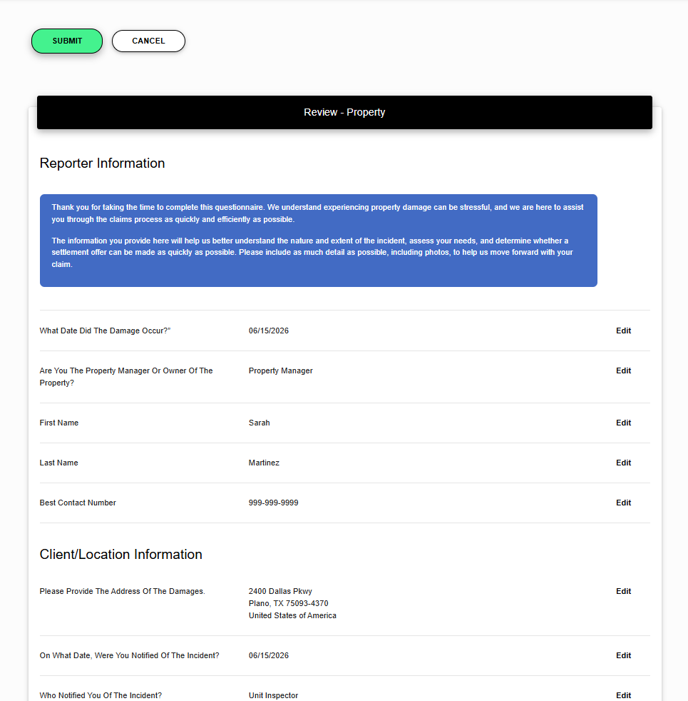
Review and Submit
Click Submit to finalize your claim. Unsubmitted claims are not received and you will need to start over.
For
Technical questions about your claim submission, contact: 860.626.9943 or Robin.Doran@sedgwick.com
RentalGuardian support, please contact: support@rentalguardian.com or (888)-885 –5550 (Prompt 2).
RentalGuardian Business hours: Mon-Sat, 8:30 AM– 5:30 PM EST
RentalGuardian Training | RentalGuardian New Damage Claims Enhancement
11

Slide 15
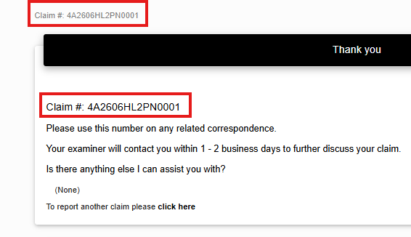
Claim Number
After you click Submit, a confirmation screen will appear with your claim number. Copy and save this number — you’ll need it to register and track your claim.
You can also report another claim (highlighted in yellow) related to a different reservation directly from this confirmation screen.
After submission, allow up to 24 hours before tracking your claim.
RentalGuardian Training | RentalGuardian New Damage Claims Enhancement
11

Slide 16
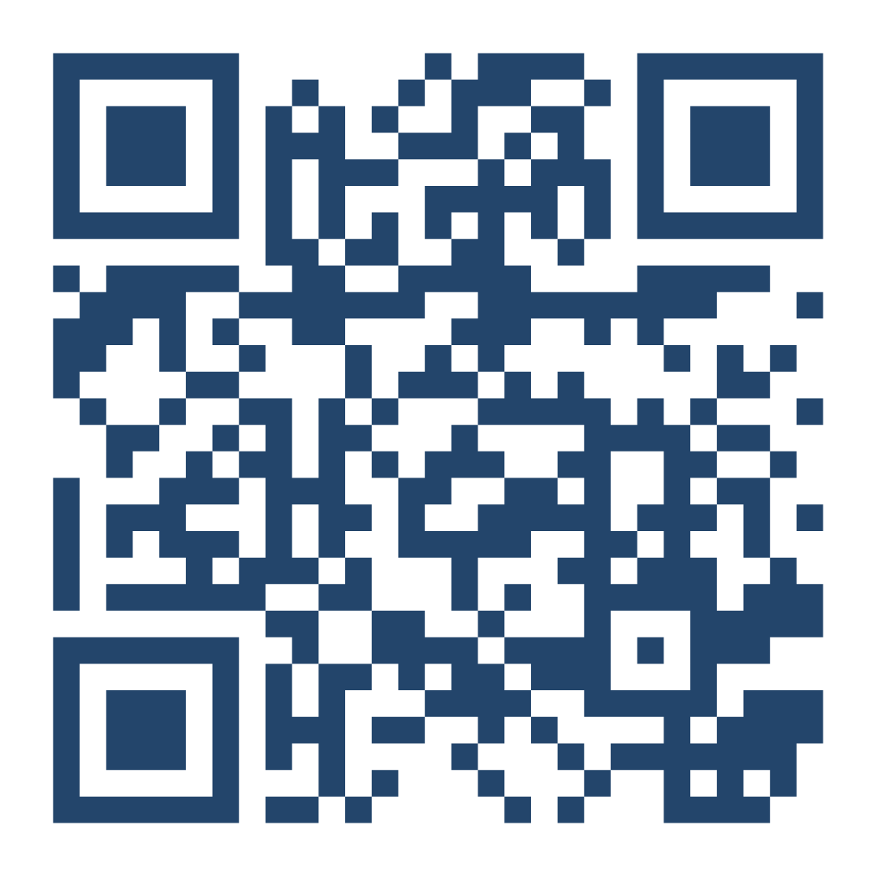
SECTION 02
Claim Tracking & Communication
Monitor your claim after submission, connect with your adjudicator, and access updates.
Powered by our claims partner, Sedgwick.
All of this — right from your mobile device or computer!

Slide 17
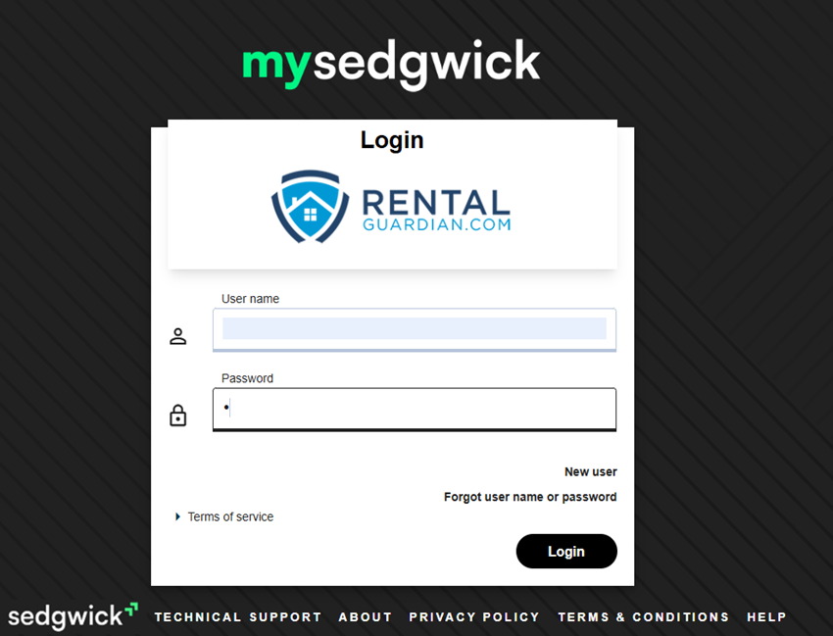
Claim Portal Sign-in
Sign in to manage your claims:
https://www.mysedgwick.com/rentalguardian
New users: sign up with your last name, address (city, state, postal code), and claim number.
After registration, sign in with your credentials.
Please note:
Claims are reviewed and managed by Sedgwick, our claims partner.
RentalGuardian Training | RentalGuardian New Damage Claims Enhancement
13

Slide 18
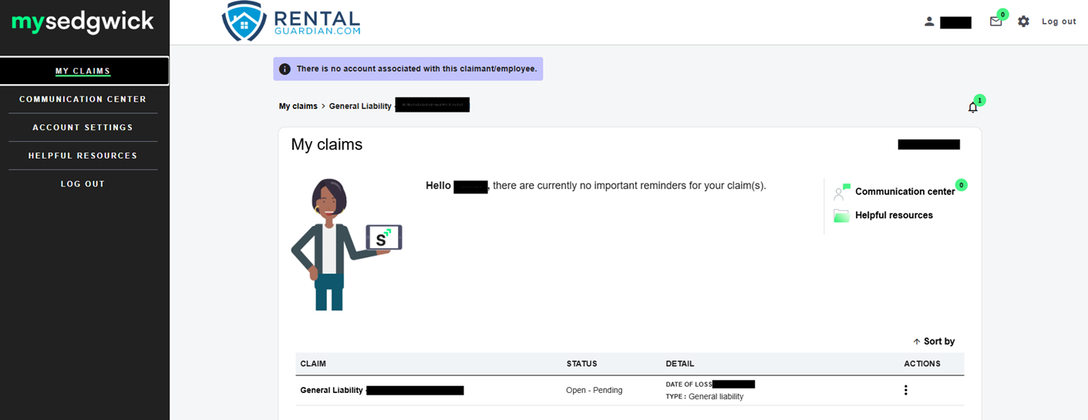
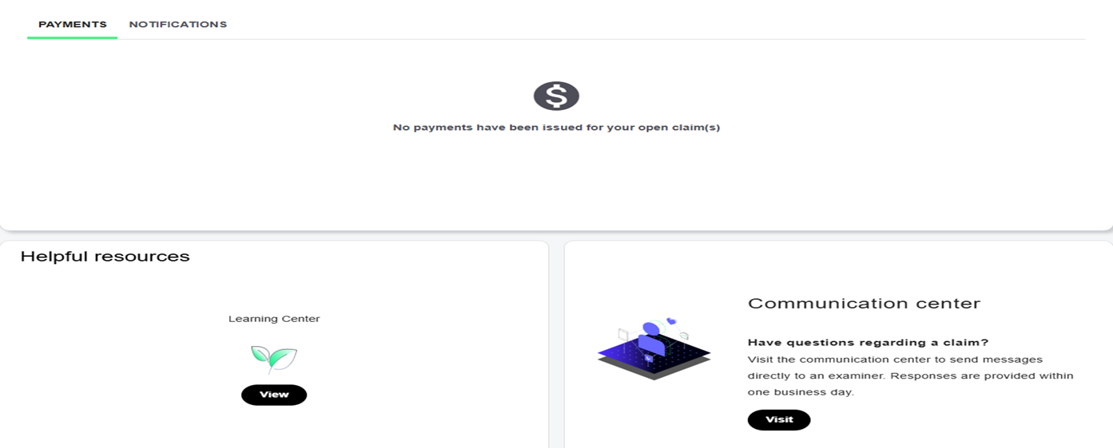
Home Page
Use the left-side navigation for primary tasks.
Click the claim number to open its dashboard.
Use the Helpful Resources and Communication Center tiles at the bottom as shortcuts to menu options.
RentalGuardian Training | RentalGuardian New Damage Claims Enhancement
14

Slide 19
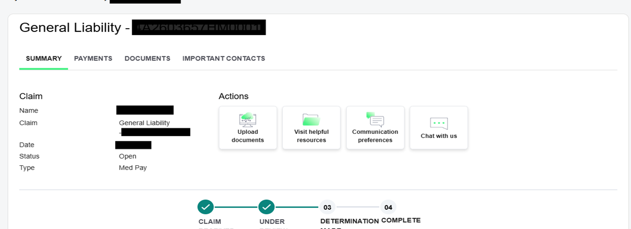
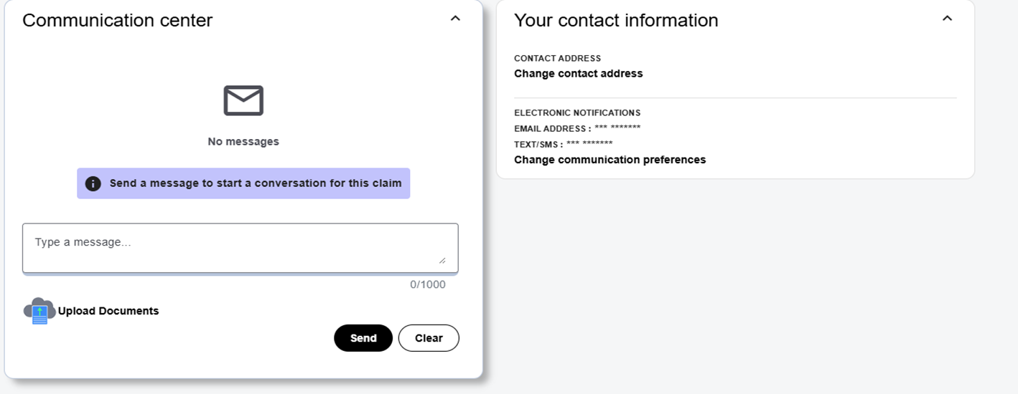
Claim Dashboard
View claim details on the left side.
Use the “Chat with us” tile to chat.
You will be able to track every step of your claim in real time.
You can view pending messages to your examiner at the bottom.
RentalGuardian Training | RentalGuardian New Damage Claims Enhancement
15

Slide 20
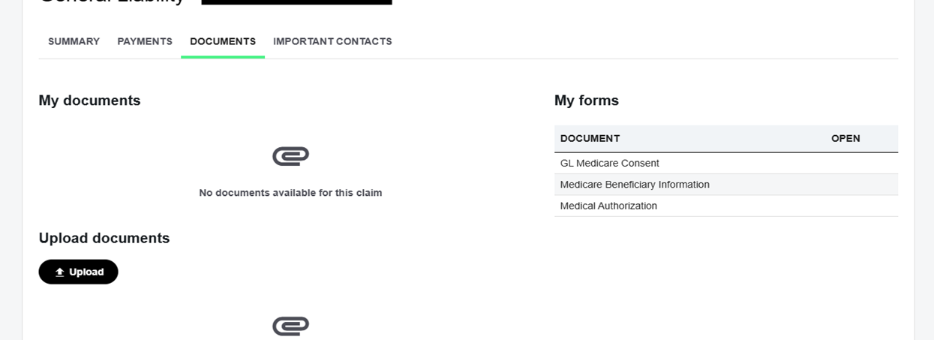
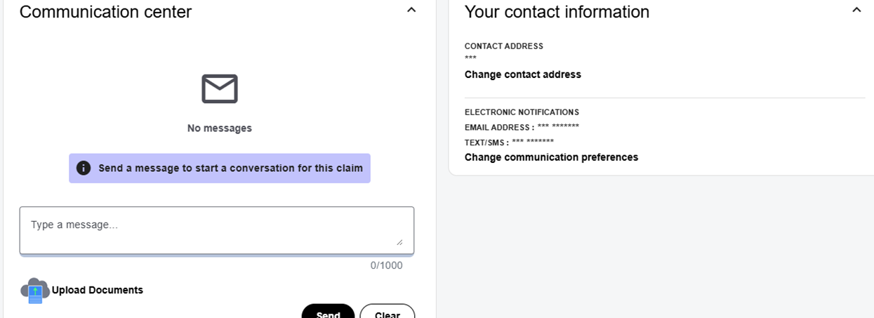
Document Upload
You can submit additional documents directly to your adjudicator after you have already submitted your claim.
Review all messages exchanged with your examiner via the Communication Center link.
Each upload will be logged to automatically update your claim.
RentalGuardian Training | RentalGuardian New Damage Claims Enhancement
16

Slide 21
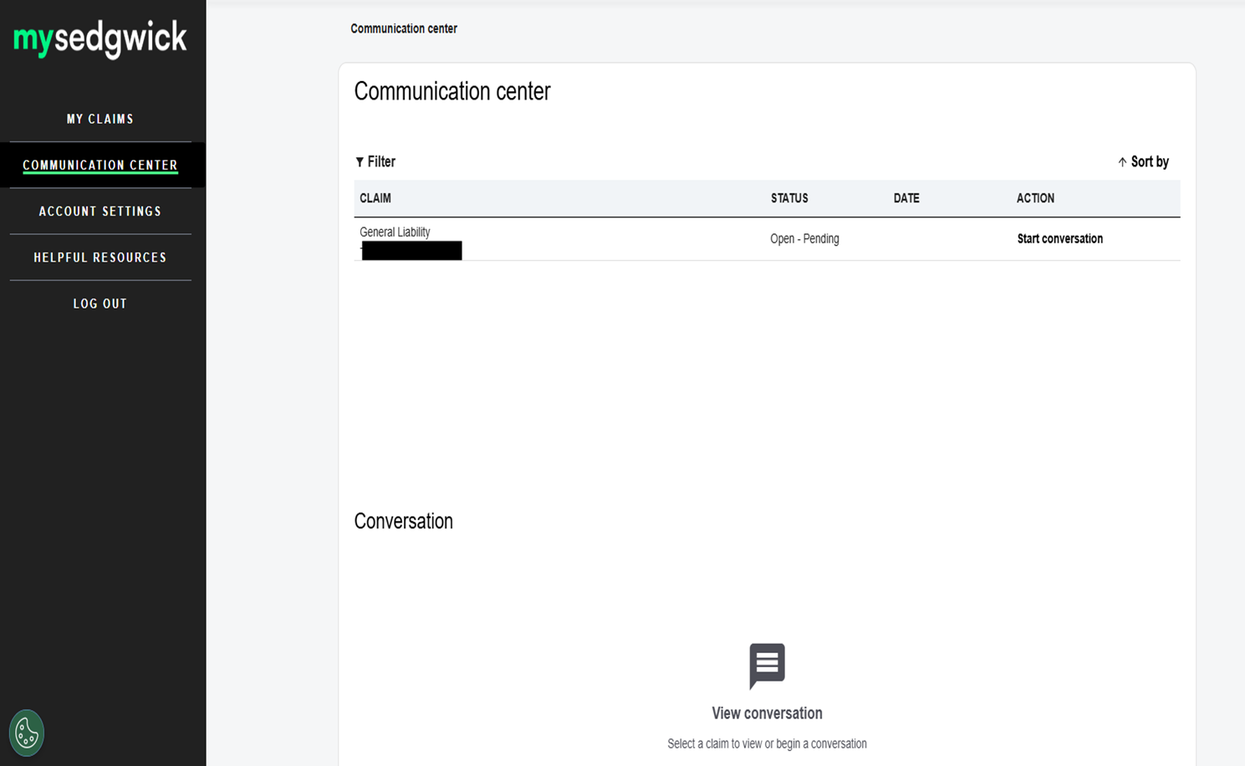
Communication Center
You can access this section from the left-side navigation in the main menu.
Here you can:
Initiate messages to your adjudicator.
Review the full history of communication.
This section serves as a central place for all claim-related correspondence.
RentalGuardian Training | RentalGuardian New Damage Claims Enhancement
18

Slide 22
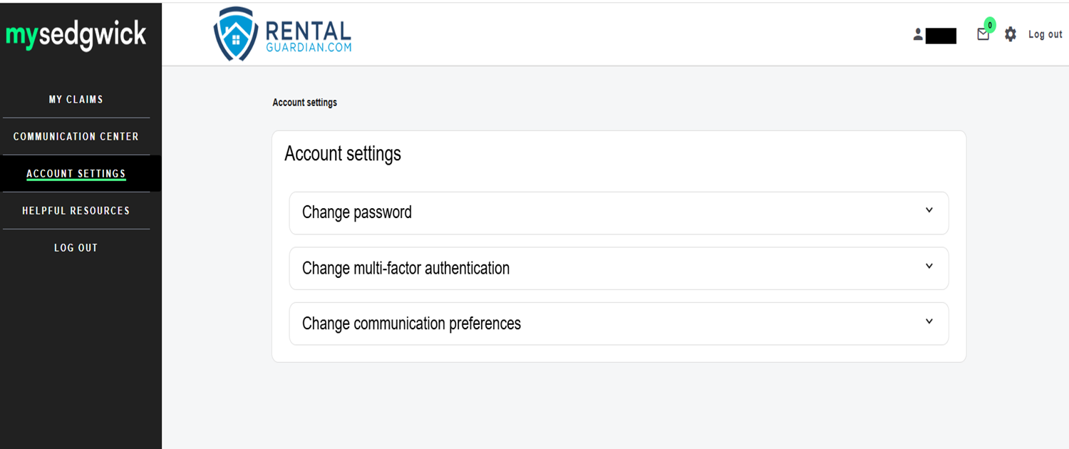
Account Settings
You can access this section via
Account Settings in the main menu.
Here you can:
Update your password.
Manage your notification preferences and
other options shown on screen.
Keep your contact and security details
current.
RentalGuardian Training | RentalGuardian New Damage Claims Enhancement
19

Slide 23
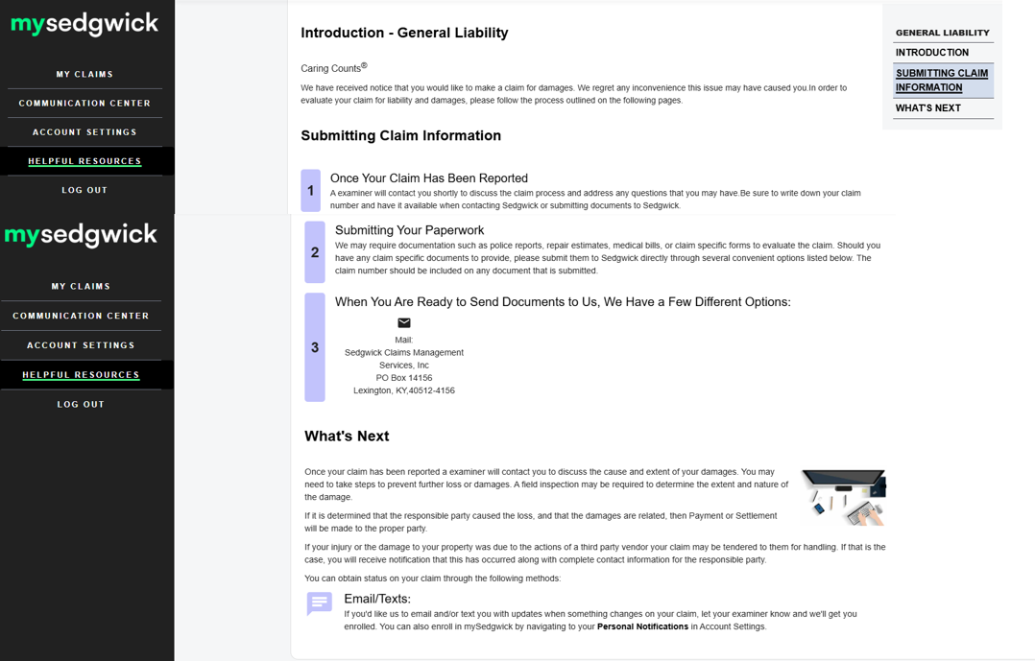
Helpful Resources
This section is a self-serve learning hub.
Select Helpful Resources from the main menu to
access.
You can find general information about the claims
process here including: FAQs, process overviews,
and guidance documents.
RentalGuardian Training | RentalGuardian New Damage Claims Enhancement
20

Slide 24
Claims Timeline & Payment
Claims are typically payable within 30 days after a decision is finalized, based on:
Coverage terms & conditions
Final judgment
Supplied documents
Payment Method
To select your preferred payment method, please log in to the mySedgwick portal.
Navigate to Direct Deposit Enrollment.
Choose how you would like to receive your payment:
  Electronic Payment (Direct Deposit)
  Mail
Please note:
  Payment by Mail is the default option if no payment preference is selected.
To enroll in direct deposit:
Provide your bank routing number and account number. (A link is provided to help locate your routing number if needed).
Authorize your enrollment and click submit to complete the enrollment.
The request is processed within 7–10 business days.
RentalGuardian Training | RentalGuardian New Damage Claims Enhancement
20

Slide 25
THANK YOU
Questions? We're here to help.
Phone
1 (888) 885-5550
Email
Sales@rentalguardian.com
Support@rentalguardian.com
RentalGuardian.com is an online service/support distribution platform, and is not a licensed insurance agency, nor does it represent or sell insurance. This presentation is not intended to be an offer to solicit or sell RentalGuardian.com Recommended Platform Provider insurance programs in any jurisdiction where a RentalGuardian.com Recommended Platform Provider or their Underwriter(s) are not authorized or where such action would be unlawful. Only licensed insurance agents are qualified to evaluate the adequacy of your coverage or provide detailed explanation of coverage provisions, terms, and conditions. Products are offered by InsureStays (dba of Sandhills Insurance Group), via the RentalGuardian.com software distribution platform. PN 16269113, California License No.: 0M14453, Texas License No.: 2194106 & 2205876.

